Slide 1
Designing, evaluating and integrating AI decision support systems in healthcare
William Bolton
CAMO-Net UK Workshop
21st June 2024

Slide 2
Objective, agenda and outcomes
Introduction
Q&A
Breakout
Goals
Conclusion
Ideate and discuss how to best design clinical decision support systems, evaluate them with clinical studies and set up infrastructure for integration
Agenda
Introduction and background
Online Q&A – mentimeter
Interactive Breakout Session
Set goals and conclude
Outcomes
Clustered opinions
User statements on design, evaluation and integration
SMART goals to work towards in the future
Education, collaboration and fun!

Slide 3


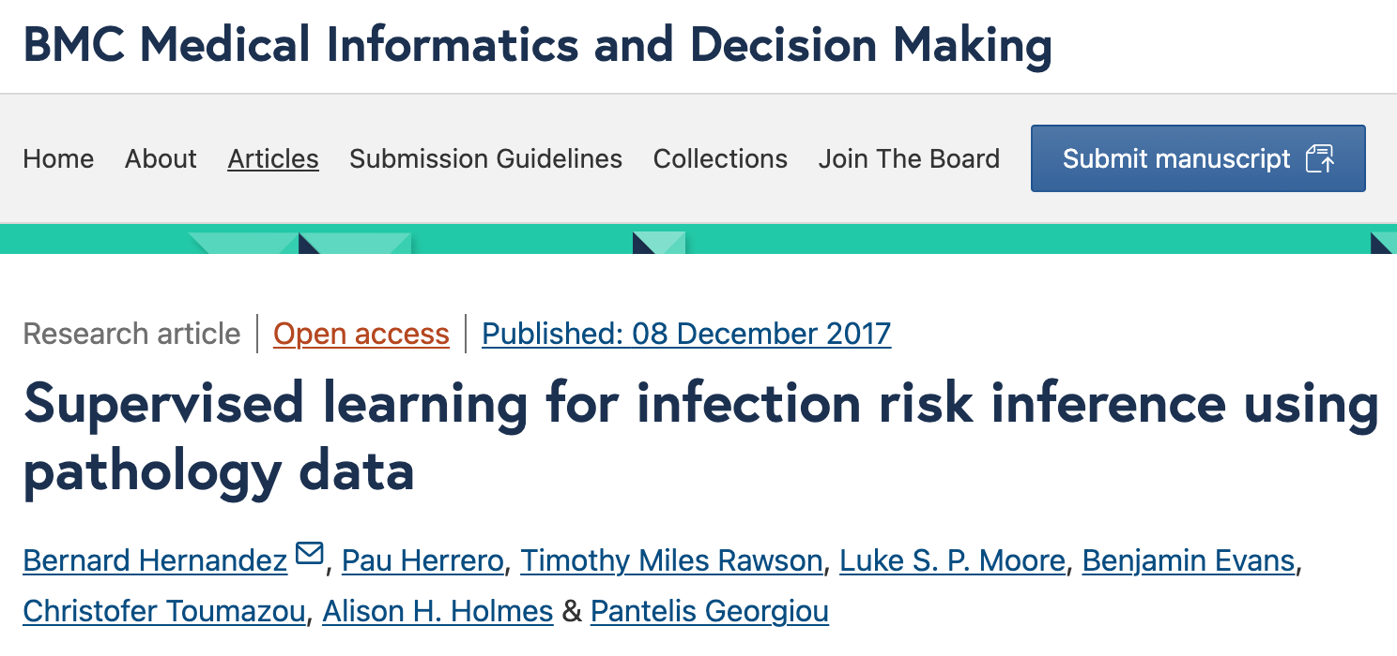
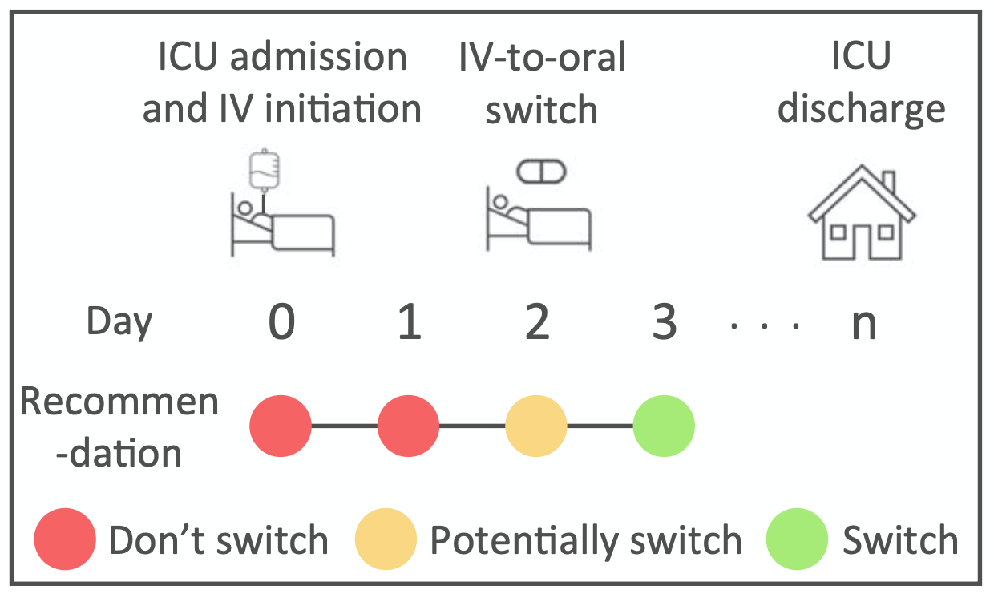
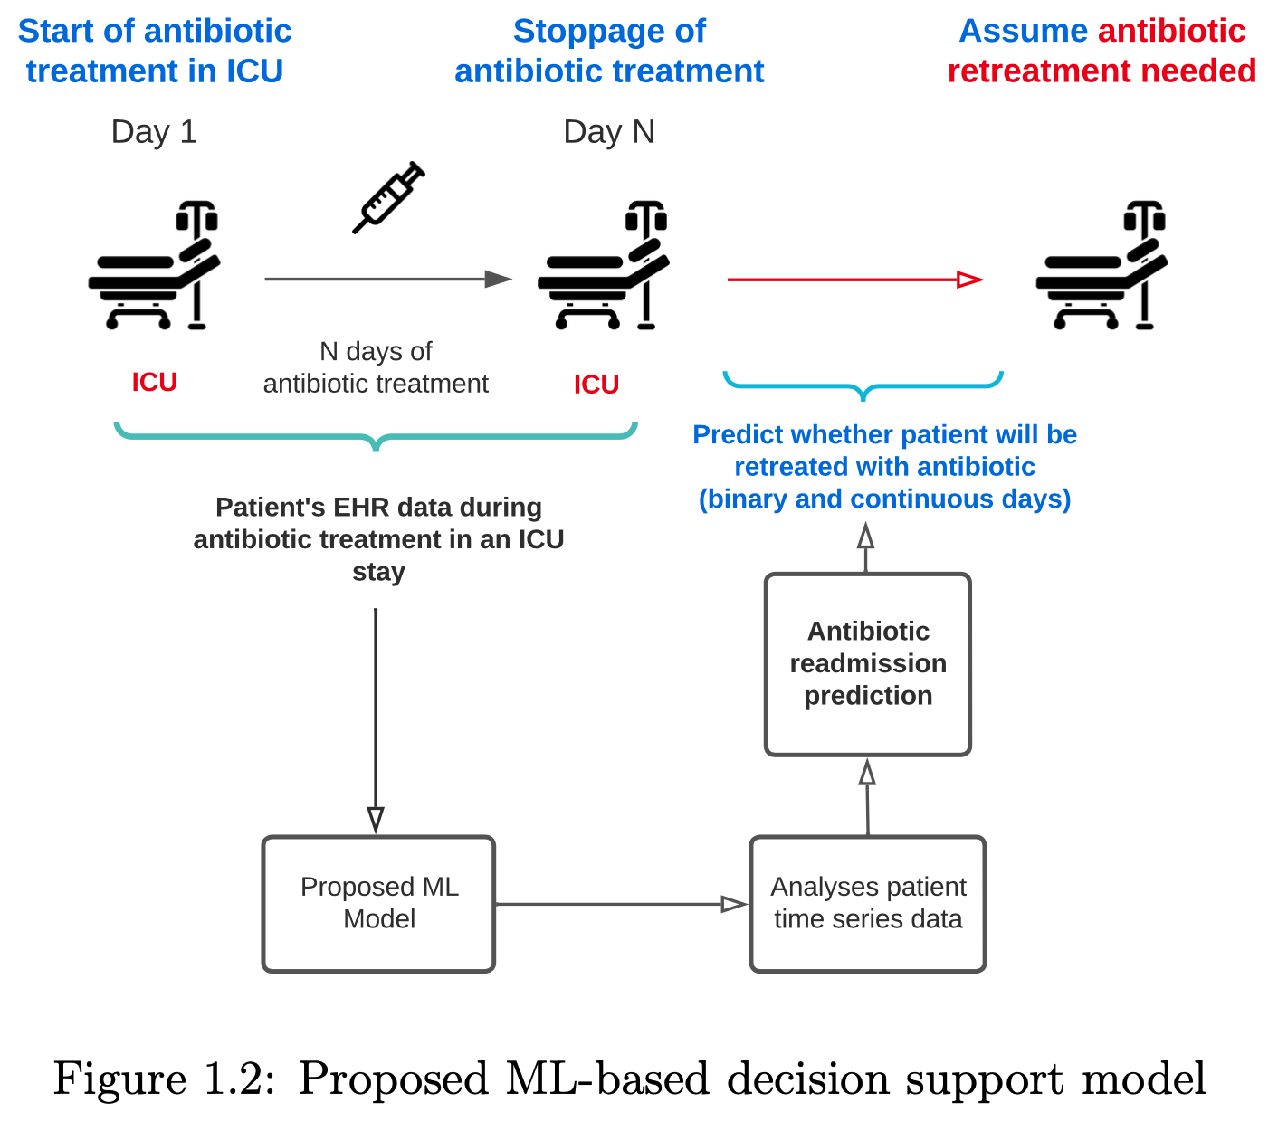

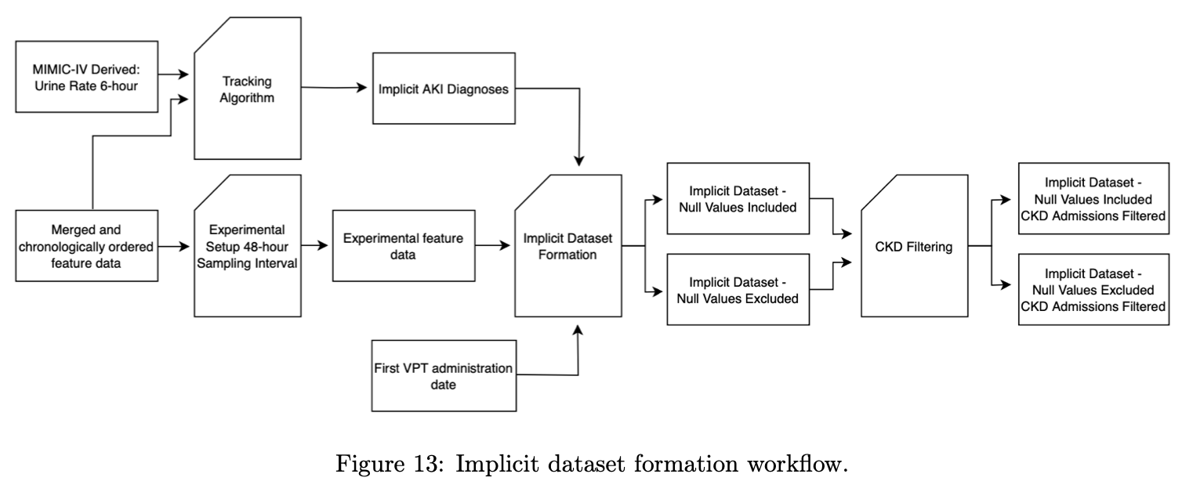
Artificial intelligence for optimised antibiotic decision making.
Introduction
Q&A
Breakout
Goals
Conclusion
STAGES OF ANTIBIOTIC DECISION MAKING
Hospital admission
Hospital discharge
Antimicrobial stewardship
0
1
2
3
IV-to-oral switch
Antibiotic readmission
Side effects
Antibiotic cessation

Slide 4
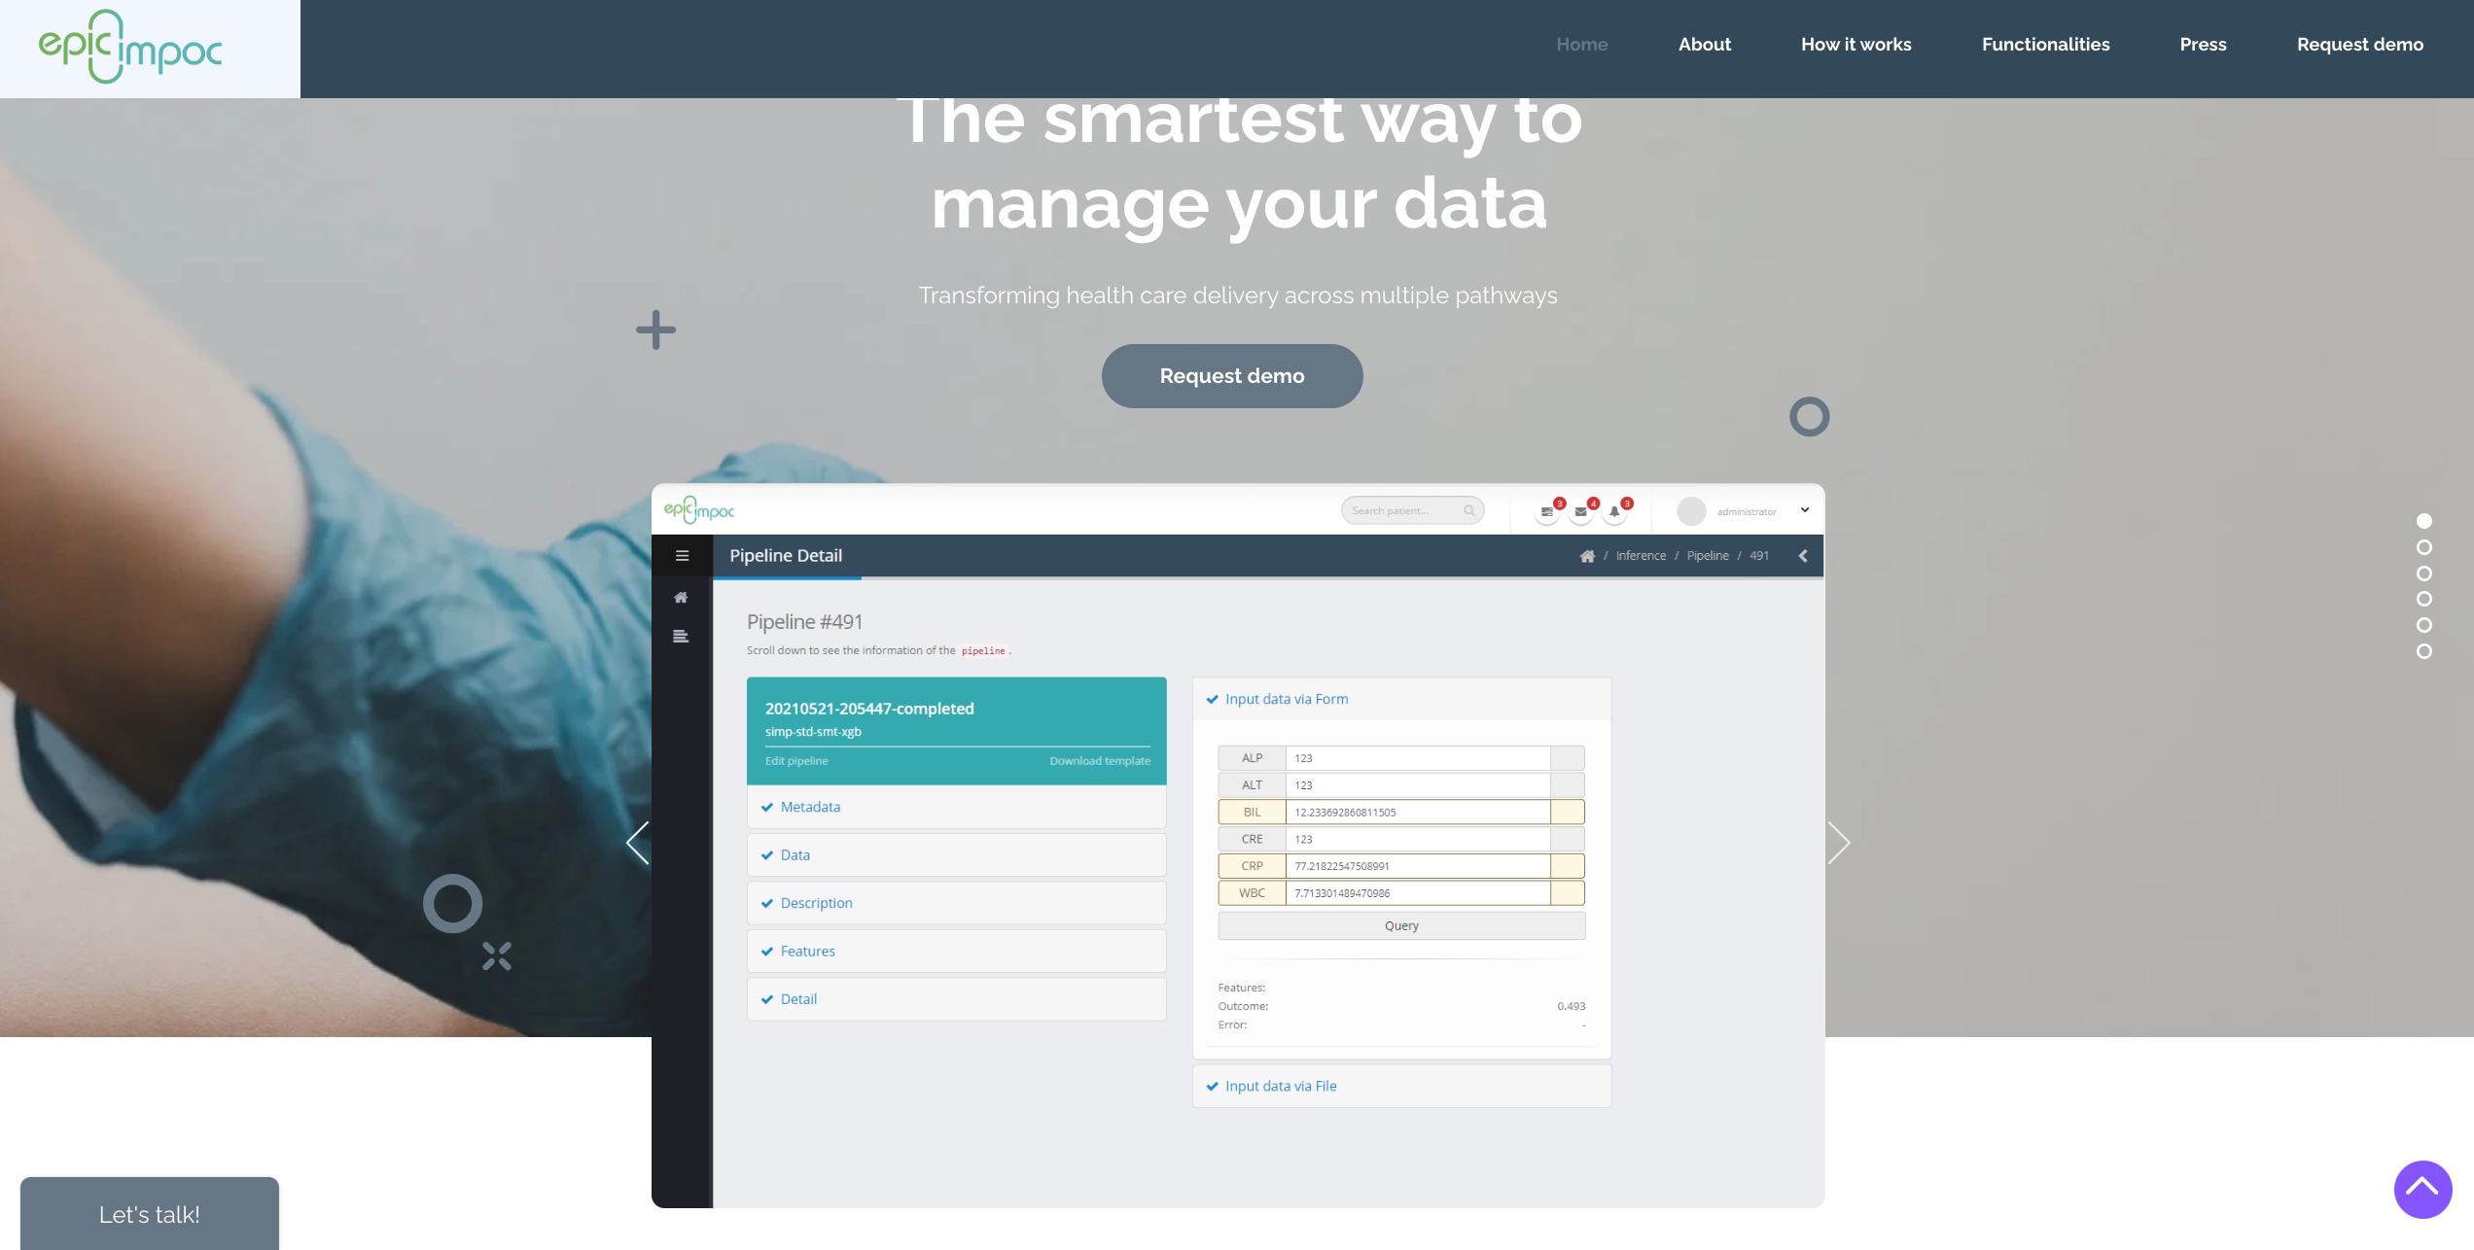


Demo of current decision support systems: EPIC-IMPOC
Introduction
Q&A
Breakout
Goals
Conclusion
Geoloaction
Microbiology
Management
2D Latent Space

Slide 5




Demo of current decision support systems: AI-IVOS
Introduction
Q&A
Breakout
Goals
Conclusion
Participate in our study:
william.bolton@imperial.ac.uk
If you are a clinician and would like to participate in a research study investigating how a novel AI clinical decision support system can support intravenous to oral antibiotic switch decision making, please email us ☺
We are particularly interested in recruiting those who are more junior and generalist
Demo

Slide 6
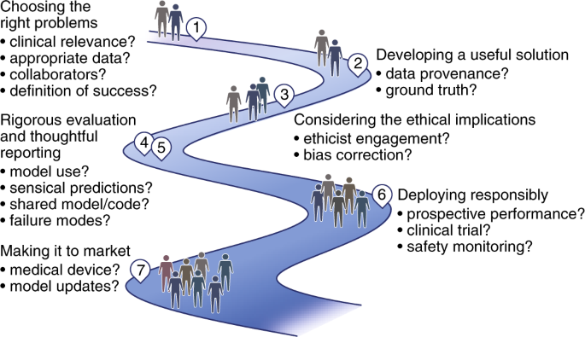
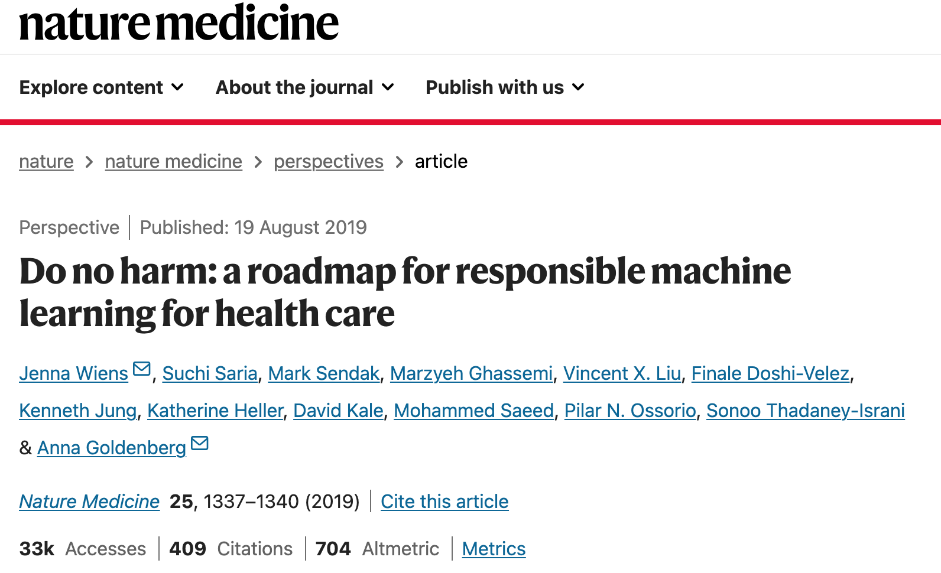
Can we create a roadmap for responsibly designing, evaluating and integrating AI in healthcare
Introduction
Q&A
Breakout
Goals
Conclusion
Wiens, J., Saria, S., Sendak, M. et al. Do no harm: a roadmap for responsible machine learning for health care. Nat Med 25, 1337–1340 (2019). https://doi.org/10.1038/s41591-019-0548-6

Slide 7
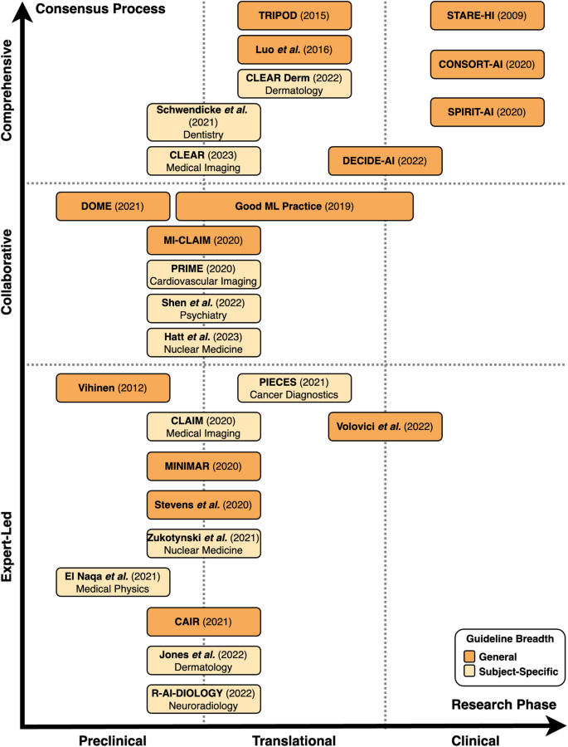
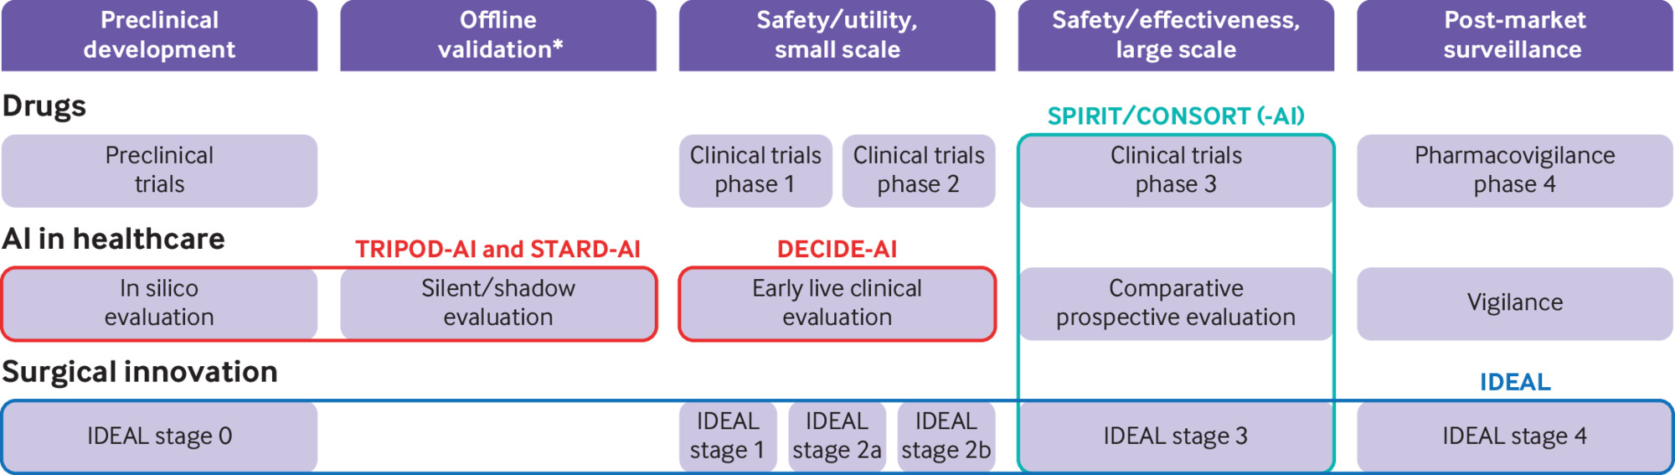
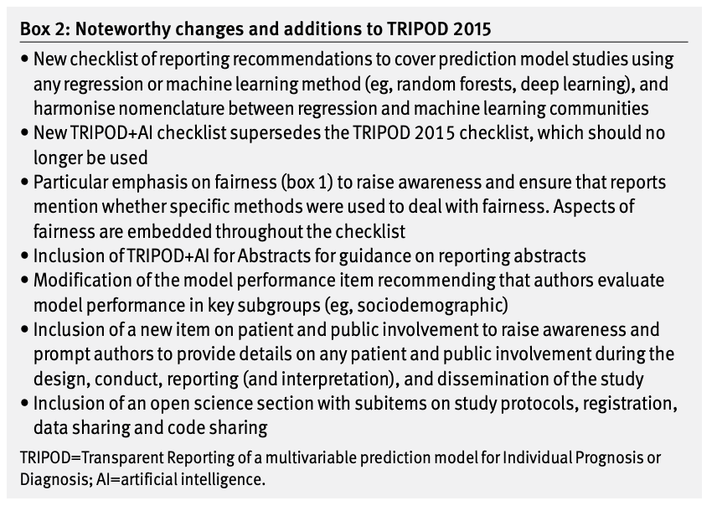
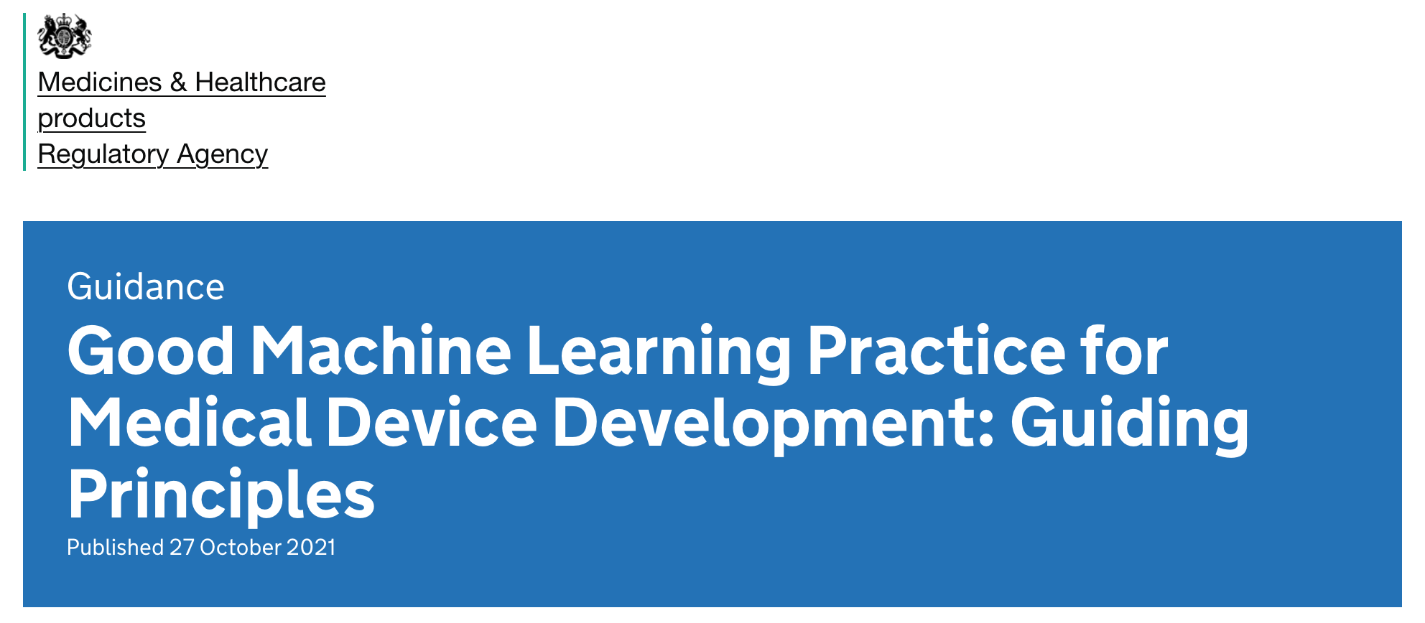
Many guidelines exist for reporting AI in medicine
Introduction
Q&A
Breakout
Goals
Conclusion
Kolbinger, F.R., Veldhuizen, G.P., Zhu, J. et al. Reporting guidelines in medical artificial intelligence: a systematic review and meta-analysis. Commun Med 4, 71 (2024). https://doi.org/10.1038/s43856-024-00492-0
Vasey B, Nagendran M, Campbell B, Clifton D A, Collins G S, Denaxas S et al. Reporting guideline for the early stage clinical evaluation of decision support systems driven by artificial intelligence: DECIDE-AI BMJ 2022; 377 :e070904 doi:10.1136/bmj-2022-070904
Collins G S, Moons K G M, Dhiman P, Riley R D, Beam A L, Van Calster B et al. TRIPOD+AI statement: updated guidance for reporting clinical prediction models that use regression or machine learning methods BMJ 2024; 385 :e078378 doi:10.1136/bmj-2023-078378

Slide 8
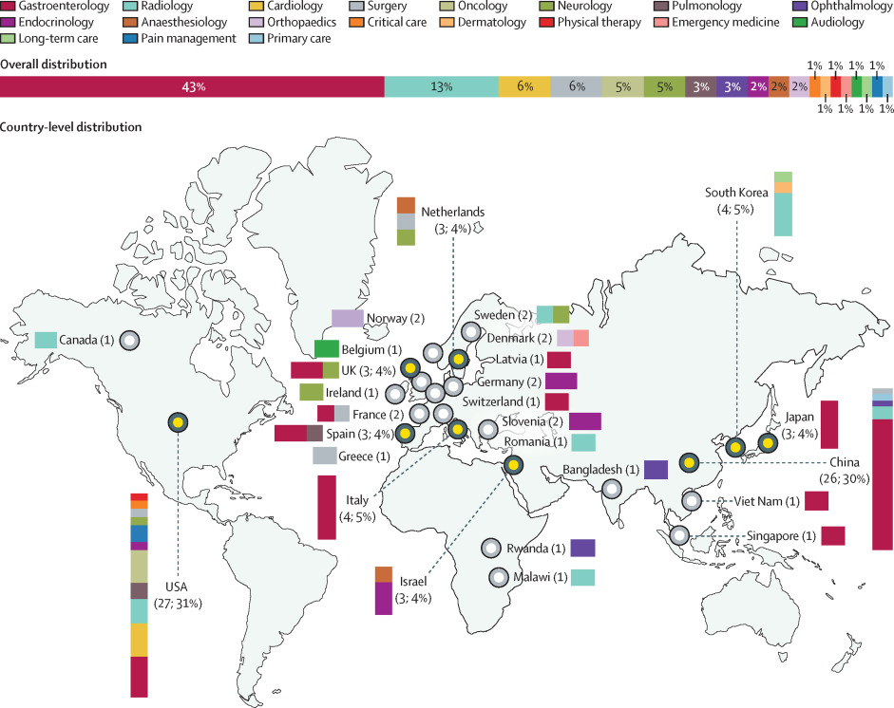
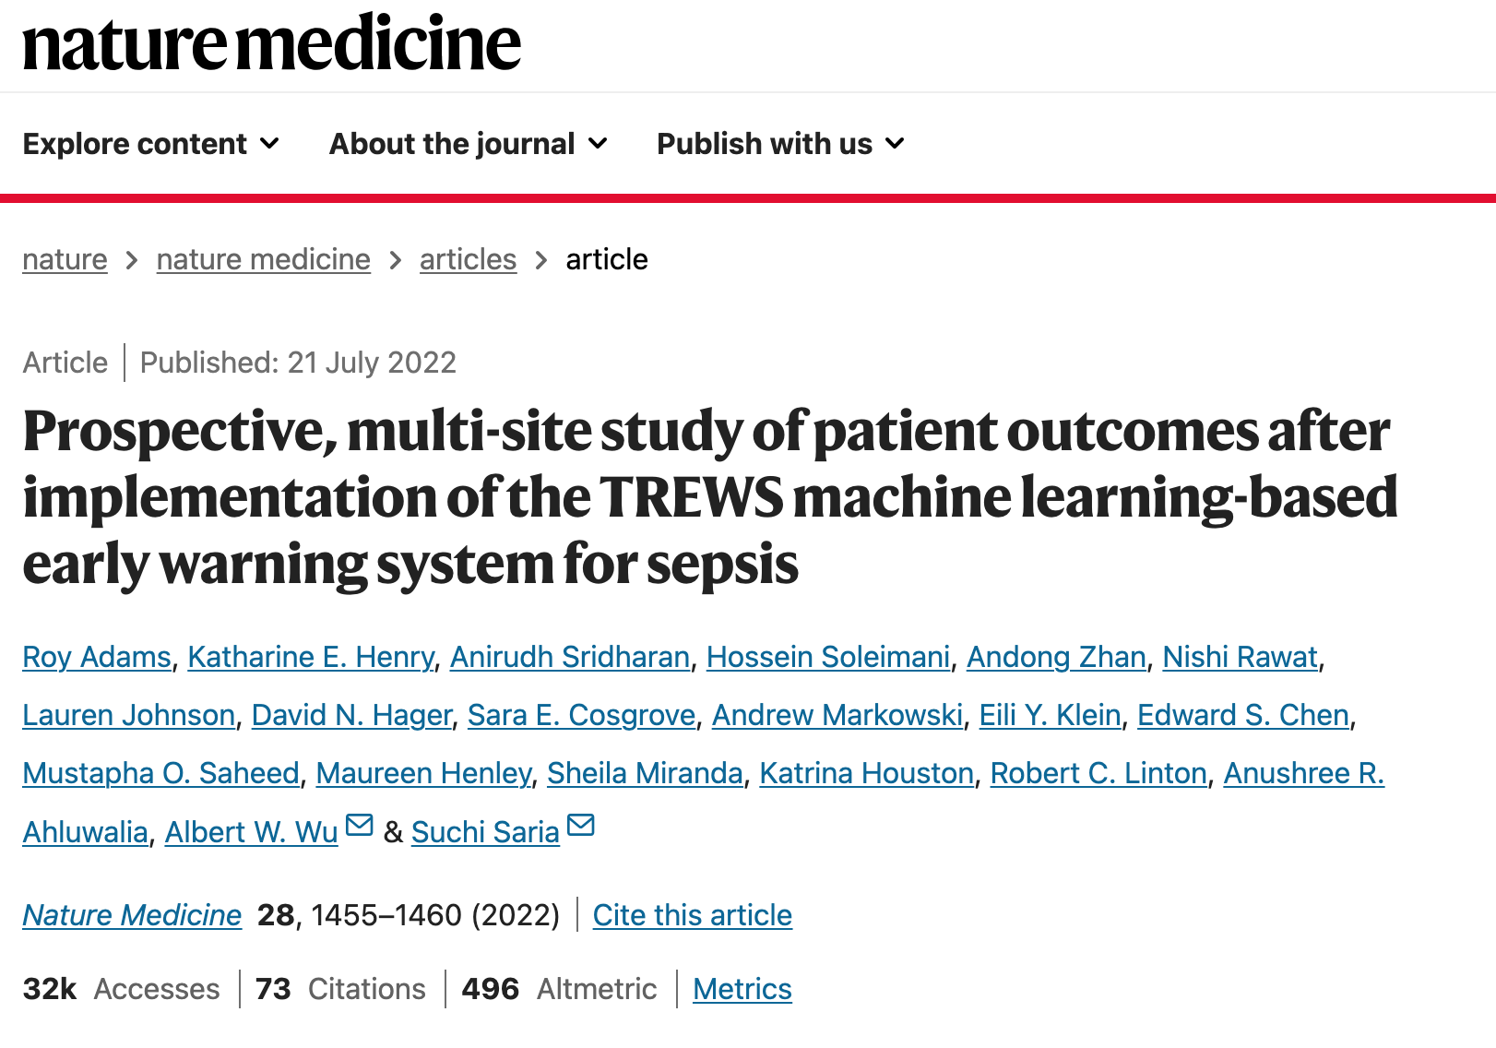
Few clinical trials of AI in real clinical practice exist - especially in infectious diseases.
Introduction
Q&A
Breakout
Goals
Conclusion
Han R, Acosta JN, Shakeri Z, Ioannidis JP, Topol EJ, Rajpurkar P. Randomised controlled trials evaluating artificial intelligence in clinical practice: a scoping review. The Lancet Digital Health. 2024 May 1;6(5):e367-73.
Adams, R., Henry, K.E., Sridharan, A. et al. Prospective, multi-site study of patient outcomes after implementation of the TREWS machine learning-based early warning system for sepsis. Nat Med 28, 1455–1460 (2022). https://doi.org/10.1038/s41591-022-01894-0

Slide 9
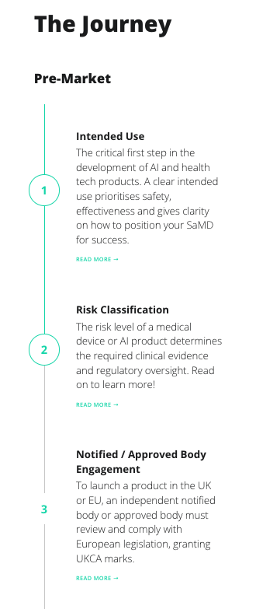
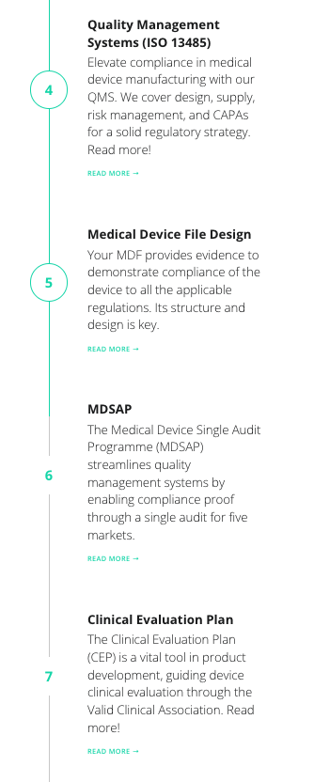
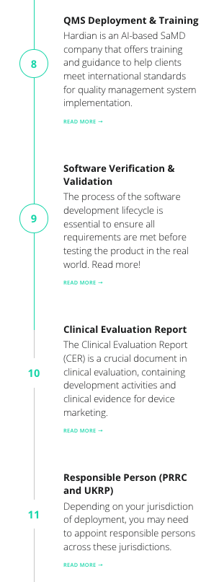
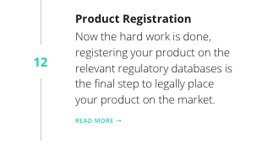
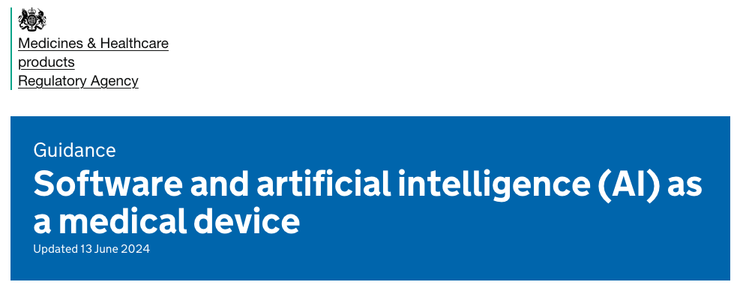
AI clinical decision support systems are regulated at a minimum as Class II software as a medical device in the UK.
Introduction
Q&A
Breakout
Goals
Conclusion
https://www.england.nhs.uk/long-read/artificial-intelligence-ai-and-machine-learning/
https://www.hardianhealth.com/regulatory
https://www.gov.uk/government/publications/software-and-artificial-intelligence-ai-as-a-medical-device/software-and-artificial-intelligence-ai-as-a-medical-device

Slide 10
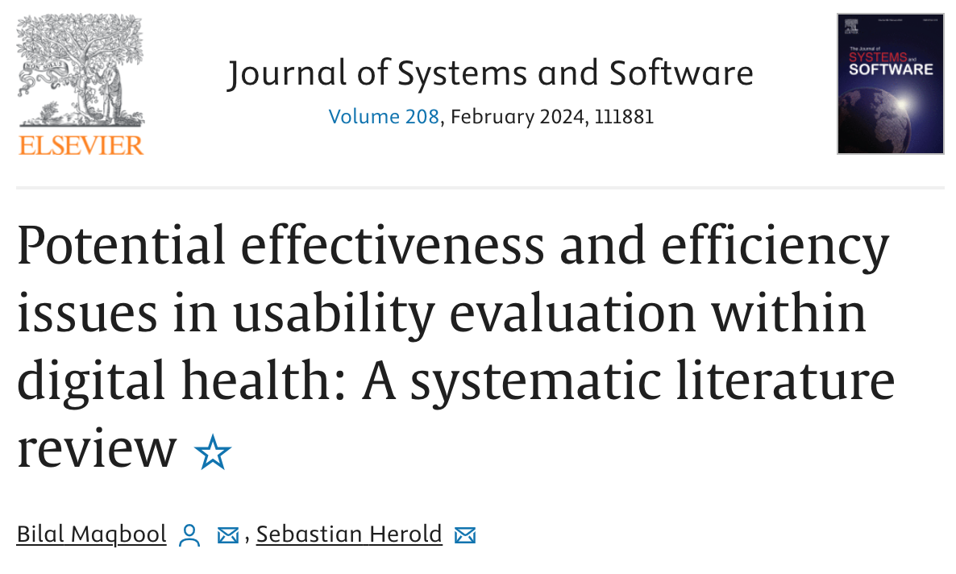
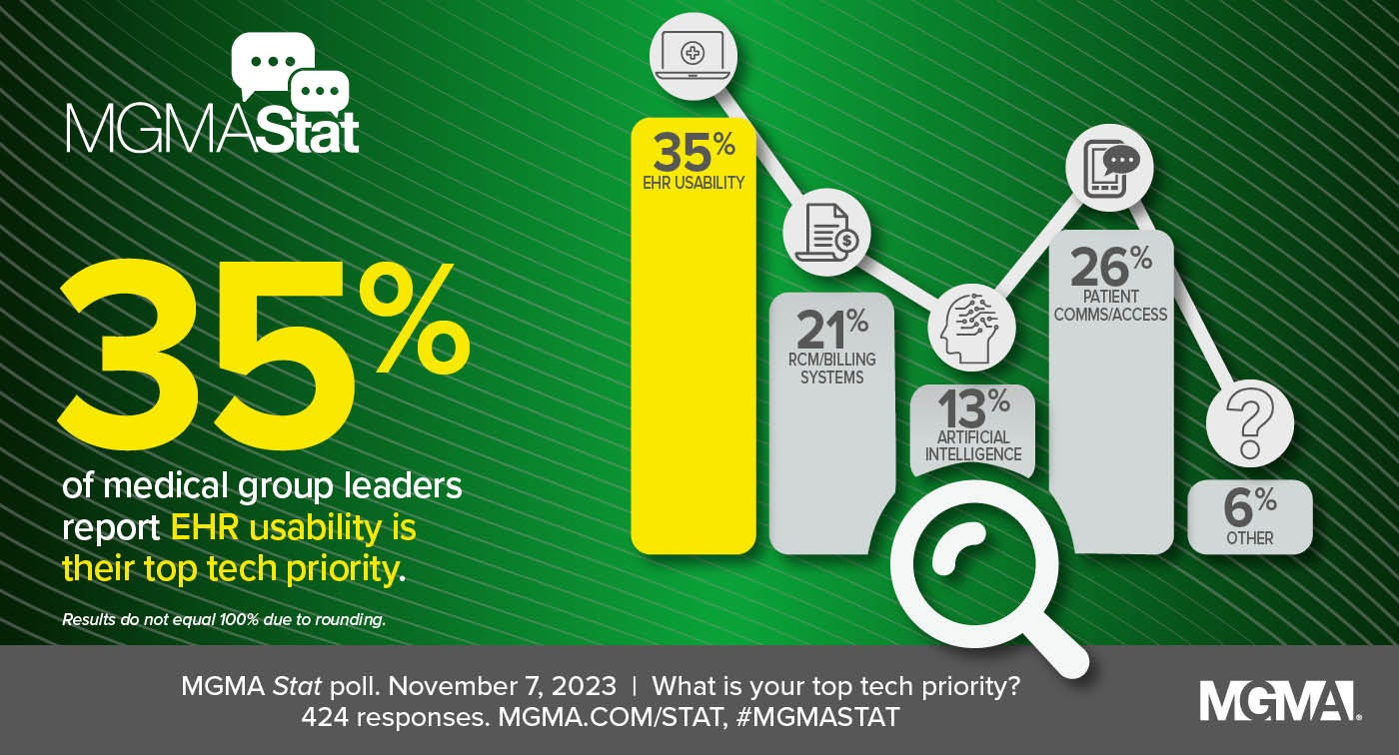
Usability is also essential for trust and adoption
Introduction
Q&A
Breakout
Goals
Conclusion
https://www.mgma.com/mgma-stat/ehr-usability-patient-communications-billing-outrank-ai-as-top-tech-priorities
Maqbool, B. and Herold, S., 2023. Potential effectiveness and efficiency issues in usability evaluation within digital health: A systematic literature review. Journal of Systems and Software, p.111881.
Notes:
and prolong current antimicrobials therapeutic life
preserve their future effectiveness
Also involves education, surveillance and collaboration
trained on historical patient data

Slide 11
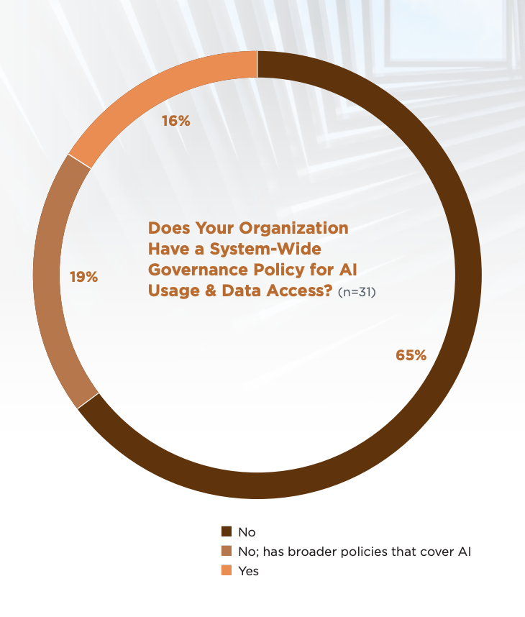
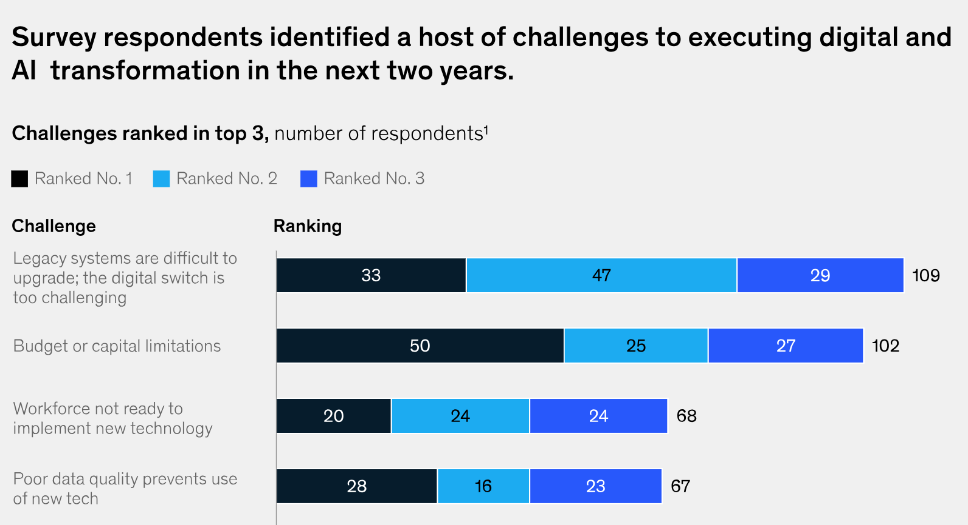
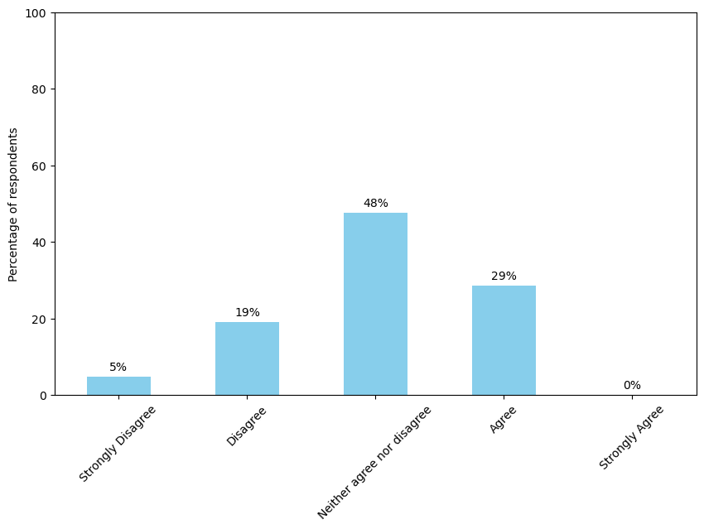
Are hospitals ready for AI?
Introduction
Q&A
Breakout
Goals
Conclusion
I think my healthcare institution has the necessary infrastructure to support this AI CDSS*
https://info.connectedmed.com/l/689353/2024-02-09/2lvknc/689353/1707510824kuJAqb0f/How_Health_Systems_Are_Navigating_The_Complexities_Of_AI_CCM_Reports.pdf?
https://www.mckinsey.com/industries/healthcare/our-insights/digital-transformation-health-systems-investment-priorities?utm_source=substack&utm_medium=email
*Unpublished research – n = 21
Notes:
and prolong current antimicrobials therapeutic life
preserve their future effectiveness
Also involves education, surveillance and collaboration
trained on historical patient data

Slide 12
Any thoughts or questions?
Introduction
Q&A
Breakout
Goals
Conclusion
Q&A
Notes:
and prolong current antimicrobials therapeutic life
preserve their future effectiveness
Also involves education, surveillance and collaboration
trained on historical patient data

Slide 13


Quick fire Q&A
Introduction
Q&A
Breakout
Goals
Conclusion
Be as creative as possible!
You can submit multiple responses
Notes:
and prolong current antimicrobials therapeutic life
preserve their future effectiveness
Also involves education, surveillance and collaboration
trained on historical patient data

Slide 14
Interactive Breakout Session!
Introduction
Q&A
Breakout
Goals
Conclusion
Split yourself into groups of 4-6
Try to ensure an even split of skills
Work with those you don’t normally collaborate with
Nominate a leader to speak
Each group will be assigned a topic:
Design / usability
Clinical evaluation
Integration
3. You will have 8 minutes to to discuss and come up with 5 statements of the form: User – Need/Goal – Benefit/Insight/Opinion
E.g., "As a doctor, I want the AI system to automatically integrate with our EHR, to enable real-time decision support as I don't have time to manually enter patient data."
4. Each group has 2 minutes to present their statements to the rest of the group
5. Each group will rotate topic and try to build of the previous group's ideas
6. Repeat unit every group has covered every topic
Notes:
and prolong current antimicrobials therapeutic life
preserve their future effectiveness
Also involves education, surveillance and collaboration
trained on historical patient data

Slide 15
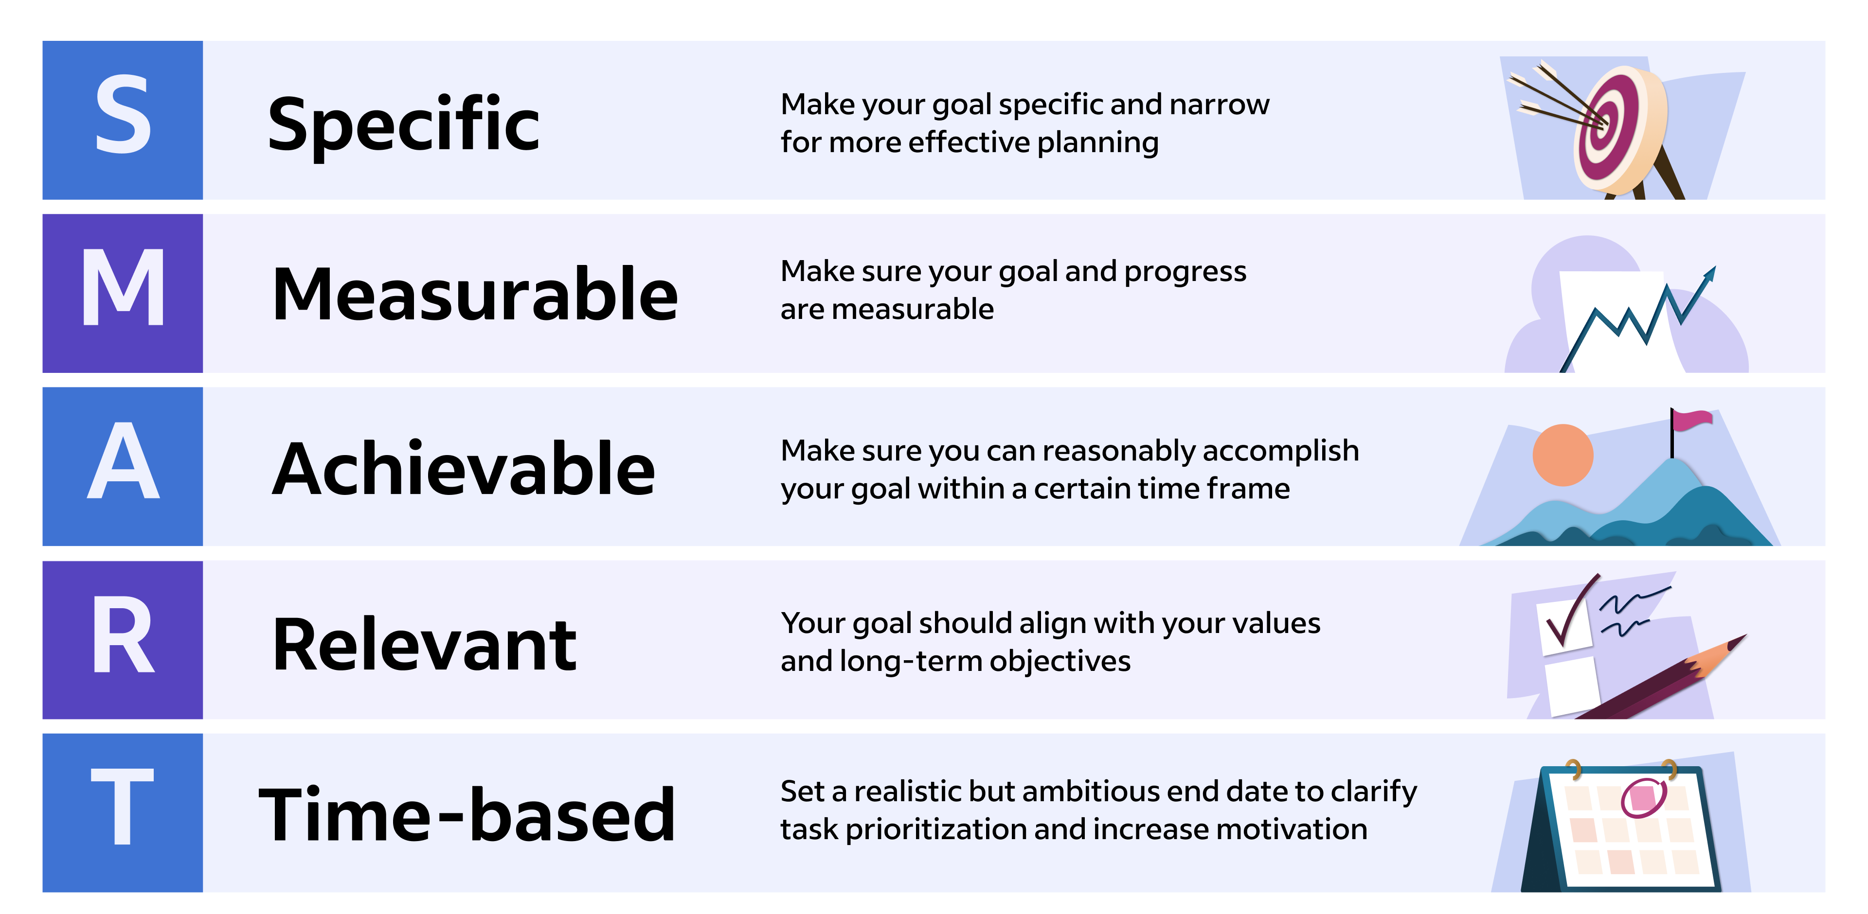
Finally let's set some future goals
Introduction
Q&A
Breakout
Goals
Conclusion
Design / usability
Clinical evaluation
E.g., By the end of the year, develop and implement a streamlined method for checking projects against current reporting guidelines and regulatory requirements. This method will include a checklist and automated reminders to ensure no critical aspects are missed. Progress will be reviewed and measured during monthly catch-up meetings to ensure continuous improvement and compliance.
Integration
Notes:
and prolong current antimicrobials therapeutic life
preserve their future effectiveness
Also involves education, surveillance and collaboration
trained on historical patient data

Slide 16
Designing, evaluating and integrating AI decision support systems in healthcare .
Introduction
Q&A
Breakout
Goals
Conclusion
Conclusion
Design, evaluation and integration are critical components towards AI clinical decision support systems for antibiotic optimisation becoming a reality in real clinical practice
Reviewed the current literature on these topics
Came up with innovative responses to ‘How might we’ questions
Ideated and discussed how to best design clinical decision support systems, evaluate them with clinical studies and set up infrastructure for integration
Developed goals to work towards in the future
Notes:
In summary, we have identified clinically relevant features and developed simple, fair, in- terpretable, and generalisable models to estimate when a patient could switch from IV-to-oral antibiotic treatment. In the future, this research will require further analysis and prospective evaluation to understand its safety, clinical benefit, and how it can influence antimicrobial de- cision making. But given AMR, HCAIs, and the interest in promoting oral therapies, such a system holds great promise to provide clinically useful antimicrobial decision support

Slide 17
I would like to acknowledge the contribution of the following individuals.
Dr Tim Rawson
Professor Pantelis Georgiou
Professor Alison Holmes
Dr Bernard Hernandez Perez
Mr Richard Wilson
Dr Mark Gilchrist
Notes:
I would like to thank these individuals for their input to this work and the UKRI and CDT for the funding

Slide 18







Thank you!
William Bolton
CAMO-Net UK Workshop
21st June 2024
william.bolton@imperial.ac.uk
Website

